Slide 1
SHA Optimization
BY: Akshay Desai
ITIS 6240
Prof. Yongge Wang

Slide 2
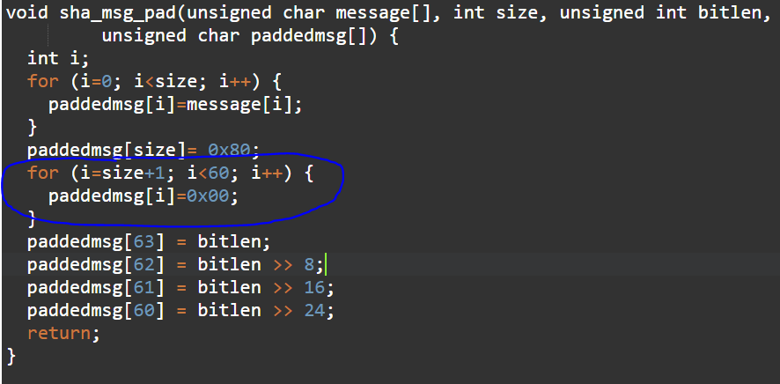
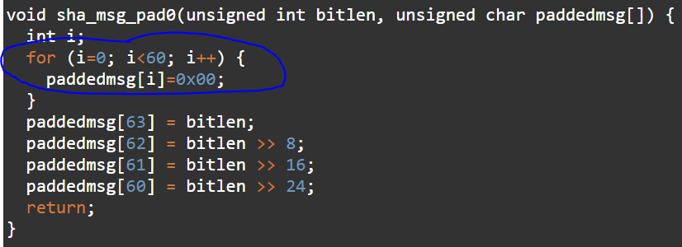
Faster sha-1 and sha-256 padding methods
Avoid longer than necessary for loops. The last 4 bytes of the full 64-byte word for SHA-1 and SHA-256 are fixed, so the for loop need only run from 0 to 60.

Slide 3
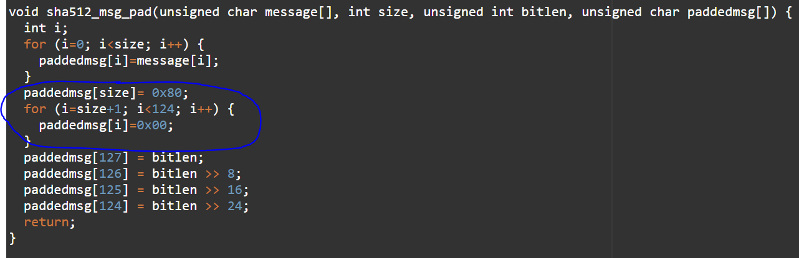
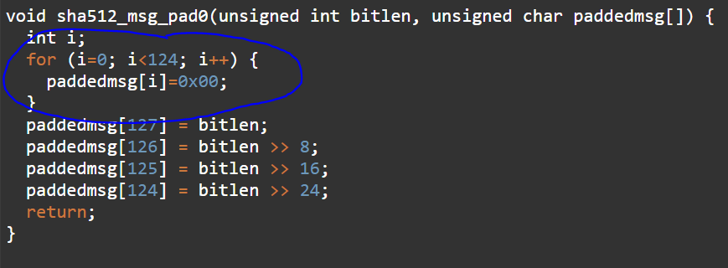
Faster sha-512 padding methods
Avoid longer than necessary for loops. Similar to SHA-1 and SHA-256, the last 4 bytes of the full 128-byte word for SHA-512 are fixed, so the for loop need only run from 0 to 124.

Slide 4
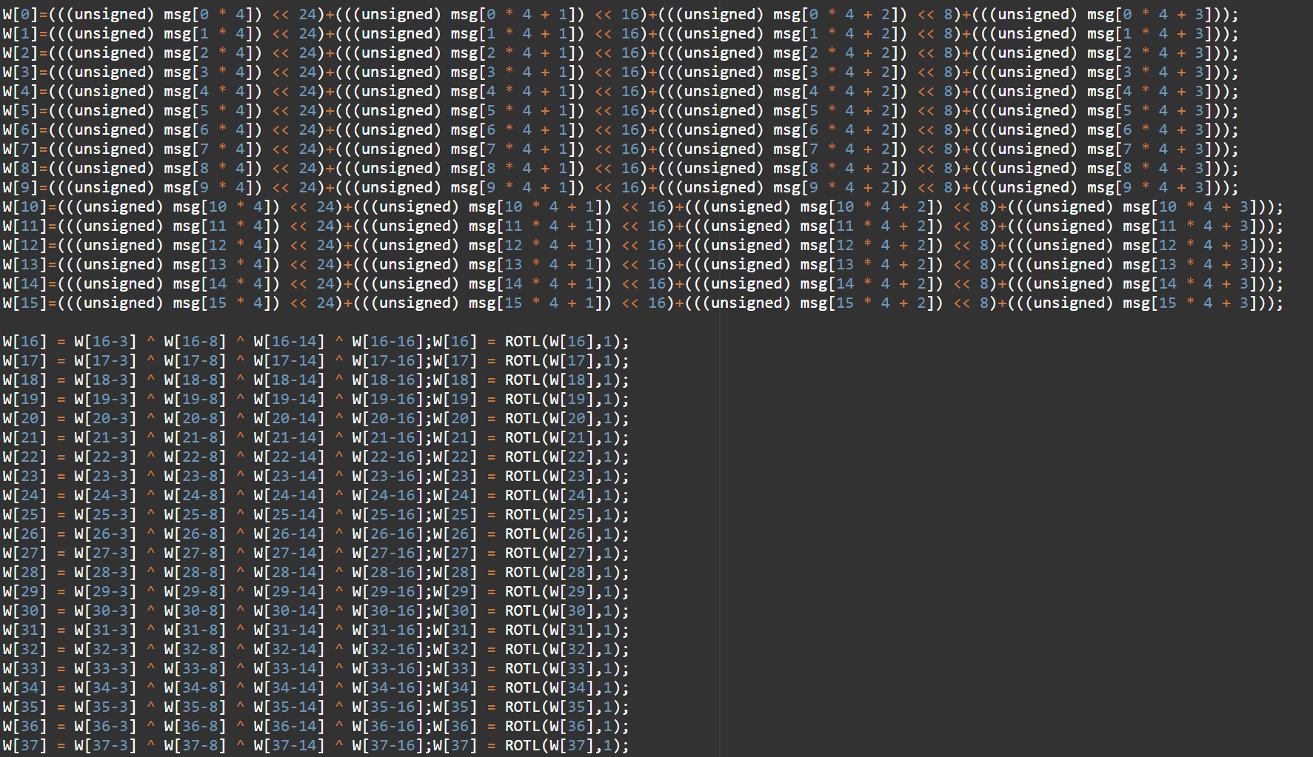
Faster sha-1 process, enumerate word generation
Avoid unnecessary for-loops to greatly improve efficiency. Here, we enumerate the for-loop for word generation during the SHA-1 process method. Enumerate the for-loop for the first 16 words, then enumerate the second for-loop for the remaining 64 words.

Slide 5
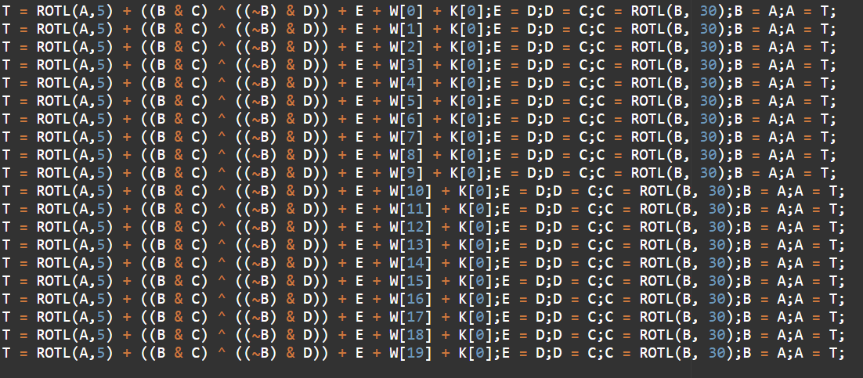
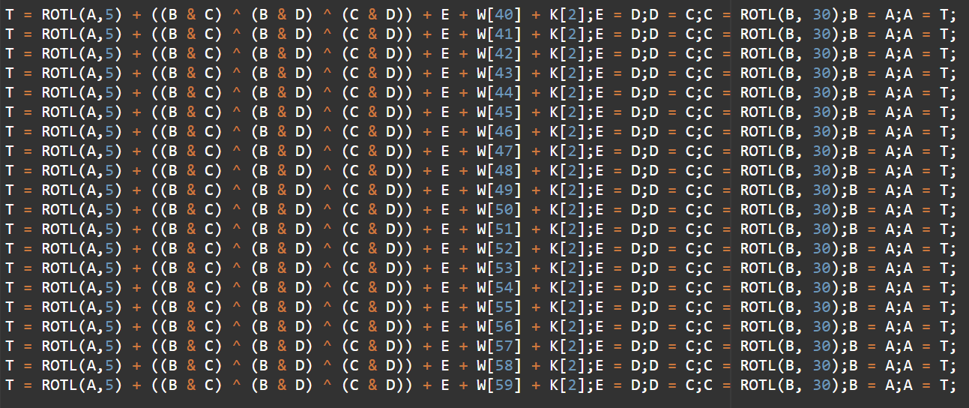
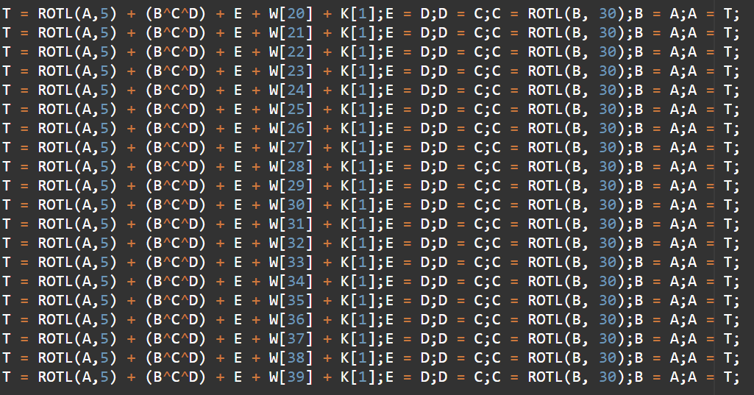
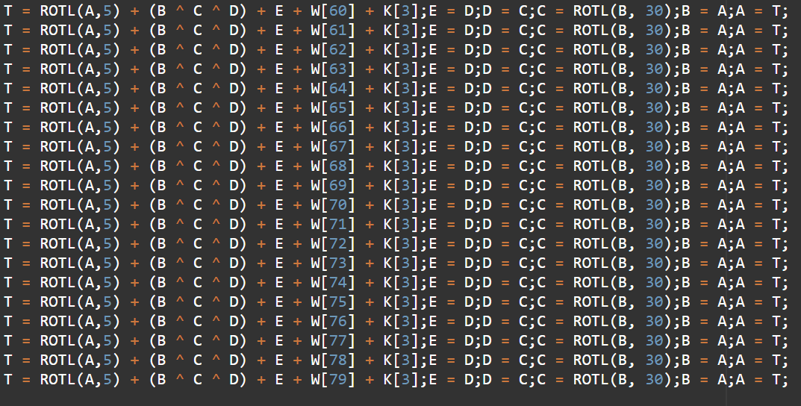
Faster sha-1 process, enumerate function manipulation
Again, avoid unnecessary for-loops to greatly improve efficiency. The functions for manipulating the words for all 80 rounds are separated with for loops incremented by 20. Make the code faster by enumerating the first 20 for-loop, then the 20 to 40 for-loop, then the 40 to 60 for-loop, and finally the remaining 60-80 for-loop.

Slide 6
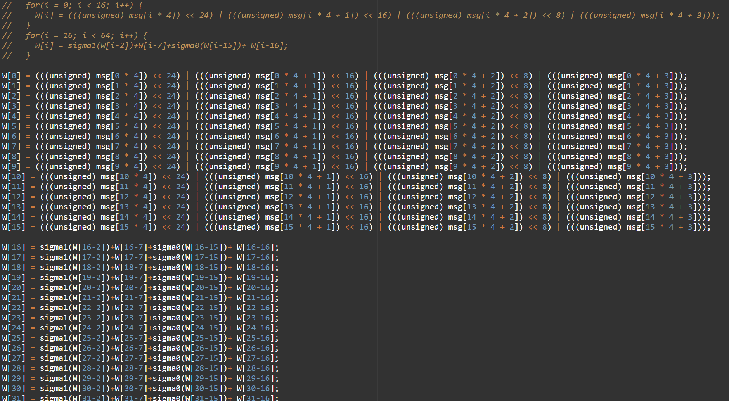
Faster sha-256 process, enumerate word generation
Again, avoid unnecessary for-loops to greatly improve efficiency.
Here, we enumerate the for-loop for word generation during the SHA-256 process method. Enumerate the for-loop for the first 16 words, then enumerate the second for-loop for the remaining 48 words.

Slide 7
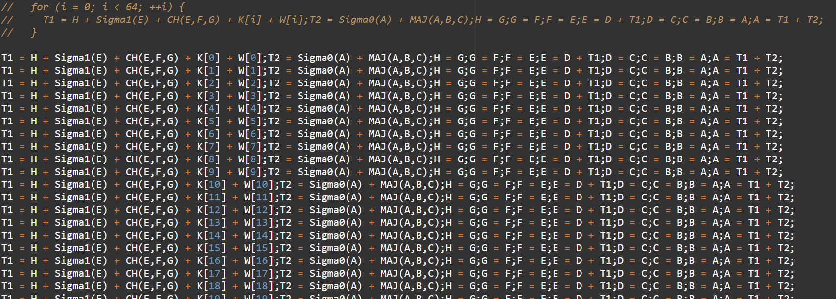
Faster sha-256 process, enumerate function manipulation
Again, avoid unnecessary for-loops to greatly improve efficiency. The function for manipulating the words for all 64 rounds is done in a single for-loop. Enumerate this, as we did for SHA-1, for quicker results.

Slide 8
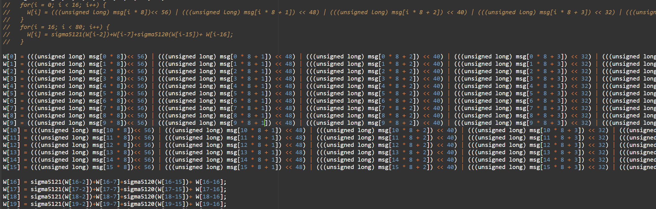
Faster sha-512 process, enumerate word generation
Again, avoid unnecessary for-loops to greatly improve efficiency.
Here, we enumerate the for-loop for word generation during the SHA-512 process method. Enumerate the for-loop for the first 16 words, then enumerate the second for-loop for the remaining 64 words.

Slide 9
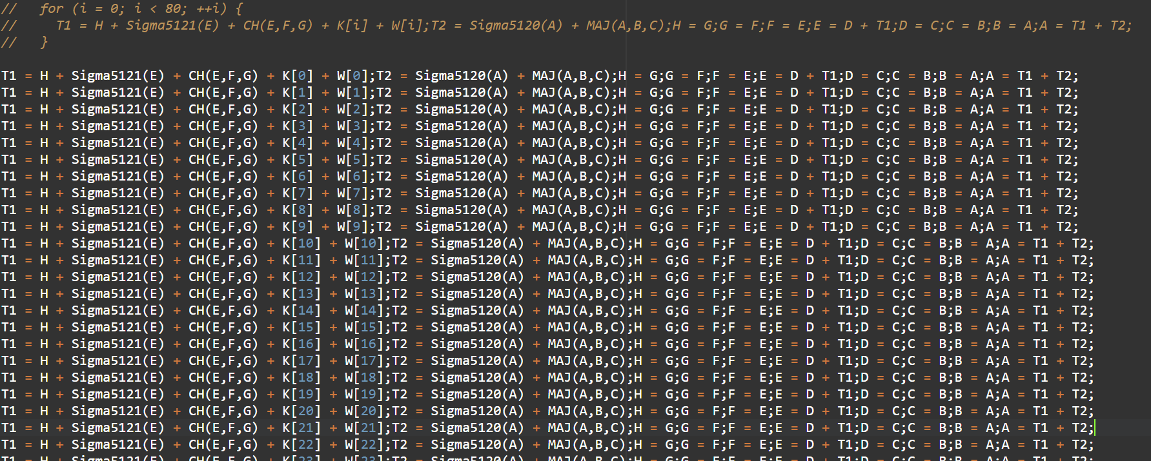
Faster sha-512 process, enumerate function manipulation
Again, avoid unnecessary for-loops to greatly improve efficiency. The function for manipulating the words for all 80 rounds is done in a single for-loop. Enumerate this, as we did for SHA-1 and SHA-256, for quicker results.

Slide 10

Old computation time

Slide 11
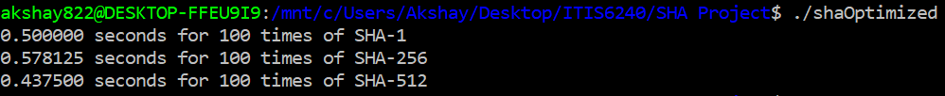
New computation time
((.906250-.500000)/.906250)*100 = 45% faster SHA-1 encryption
((.828125-.578125)/.828125)*100 = 30% faster SHA-256 encryption
((.640625-.437500)/.640625)*100 = 31% faster SHA512 encryption

